Slide 1
Capstone Design
Team 3
20163704
20161344
20164245
Park JuHyeon
Heo JeongWoo
Hong Jin

Slide 2
Contents
1.
Project Introduction
Implementation
Demo
Further Implementation Plan & Reviews
2.
3.
4.

Slide 3
1.
Project Introduction

Slide 4

1
Project Introduction
Project Title
Smoothie
“Smoothie” is a Photo Edit Program,
We select this project’s title to emphasize feeling of ‘Smooth’.

Slide 5
1
Project Introduction
Team name & Members
Team 3 – 316
Team Members – Park JuHyeon, Heo JeongWoo, Hong Jin
Three people whose student numbers are 16.

Slide 6

1
Project Introduction
Background
Many people use Adobe Photoshop to edit photos.
But it sometimes demands ability to use this program.

Slide 7
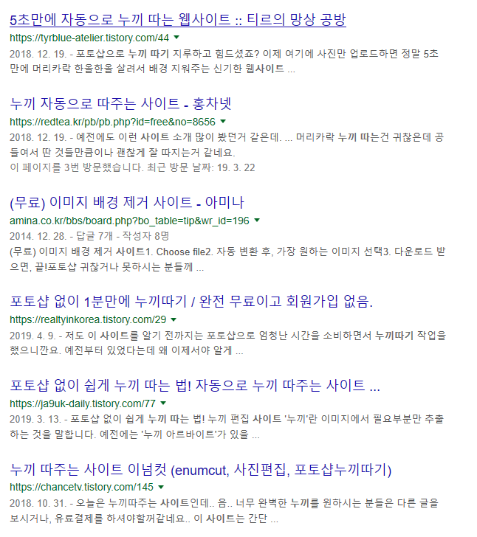
1
Project Introduction
Background
There are many website to provide easier Lasso function.

Slide 8
1
Project Introduction
Background
We are supposed to provide easier Lasso function and simple editing function to user.

Slide 9


1
Project Introduction
Topic
Model
person
Input
Output

Slide 10
2.
Implementation

Slide 11
2.1
QT

Slide 12
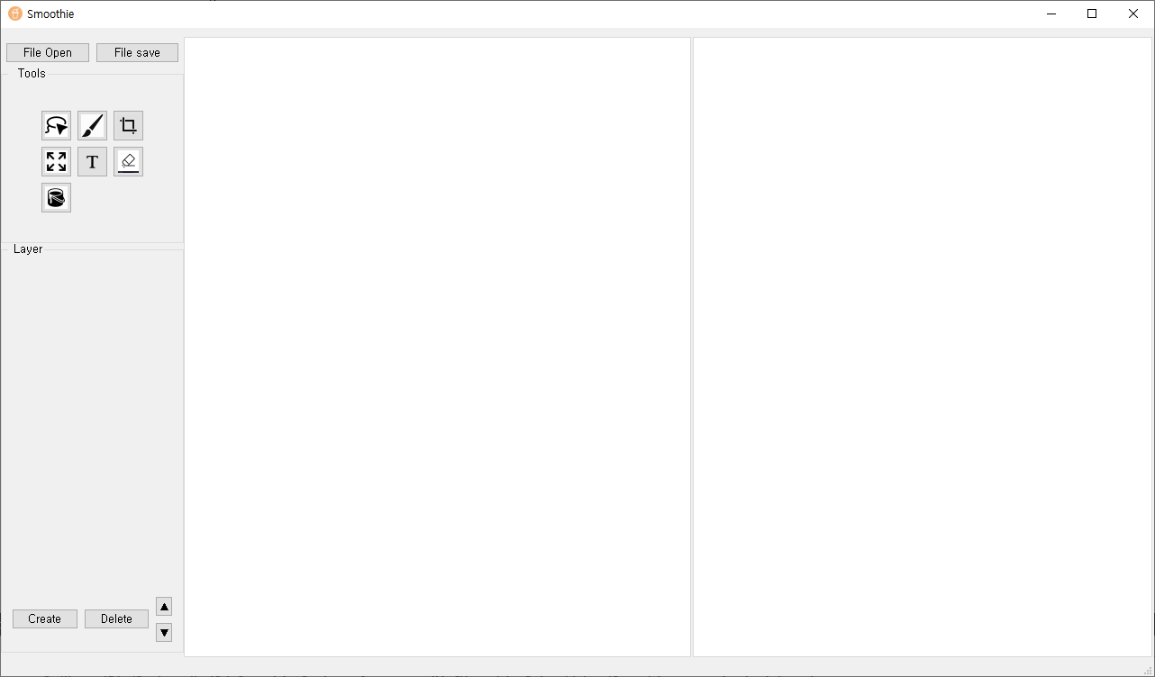
2
Progress
QT

Slide 13
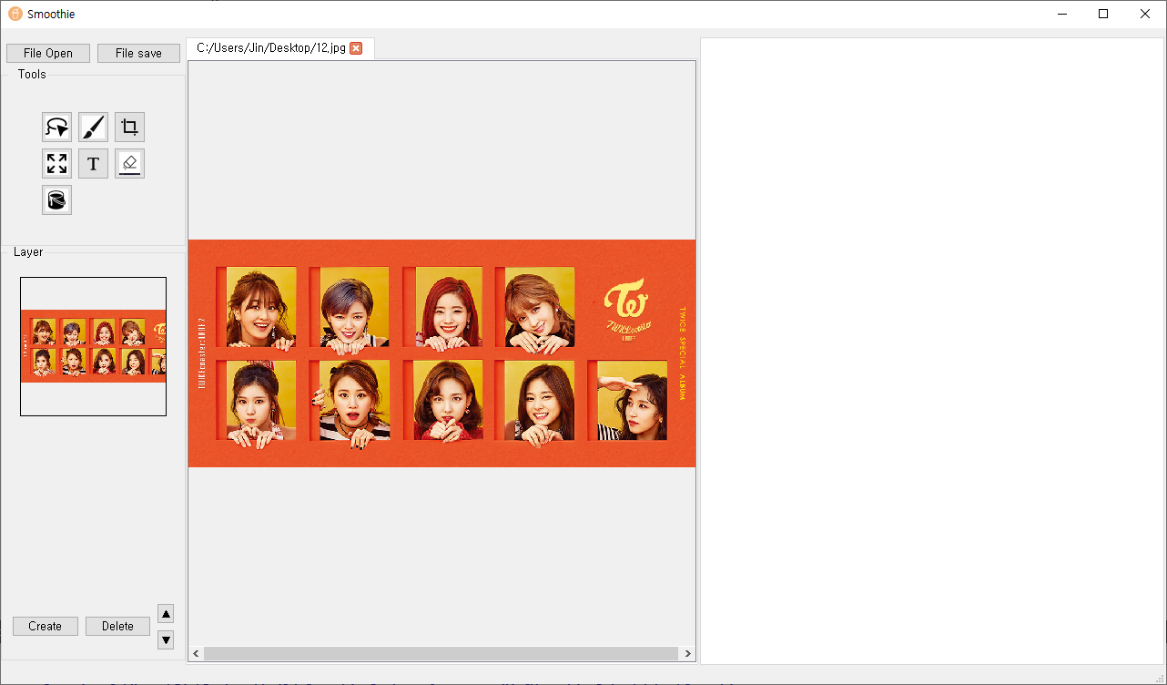
2
Progress
QT
File Open

Slide 14
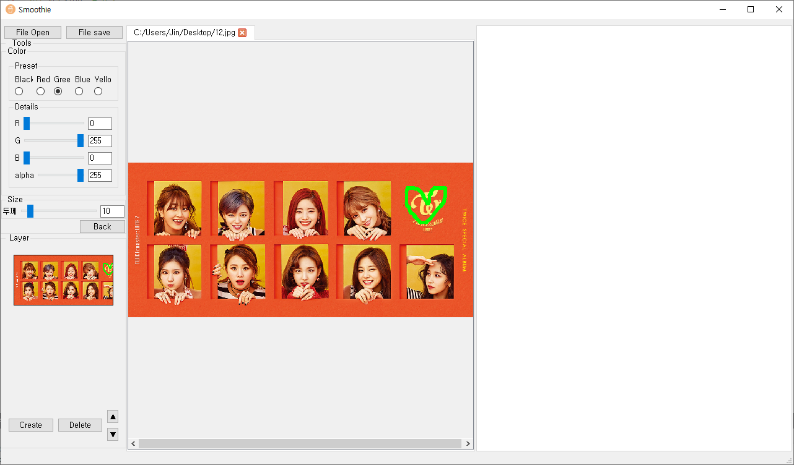
2
Progress
QT
Drawing

Slide 15
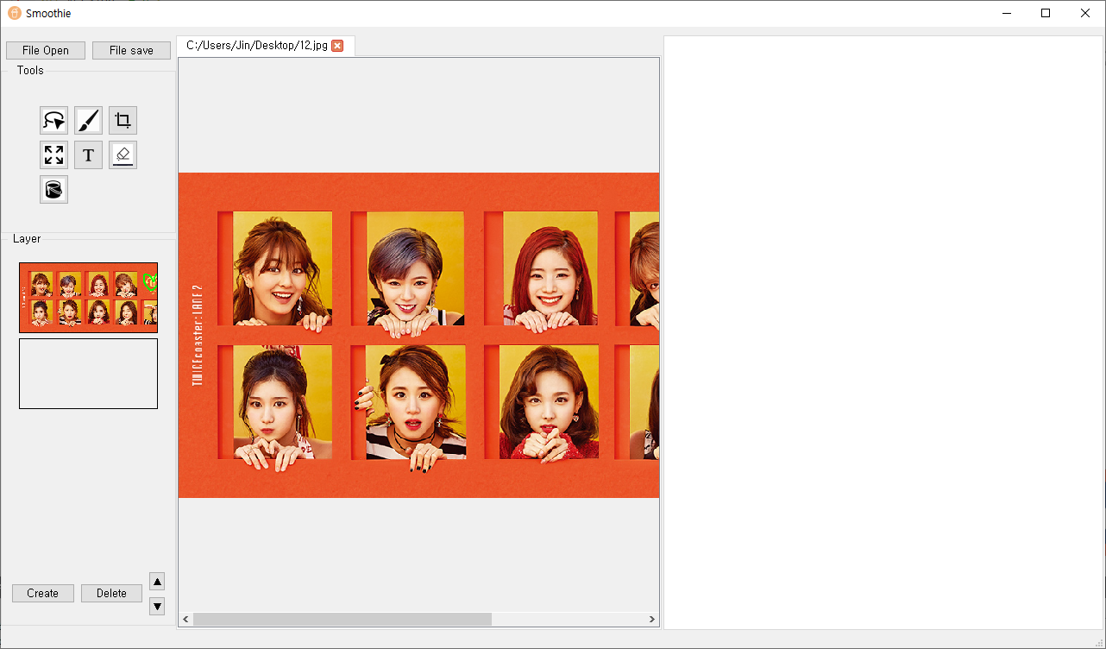
2
Progress
QT
Zoom in/out

Slide 16
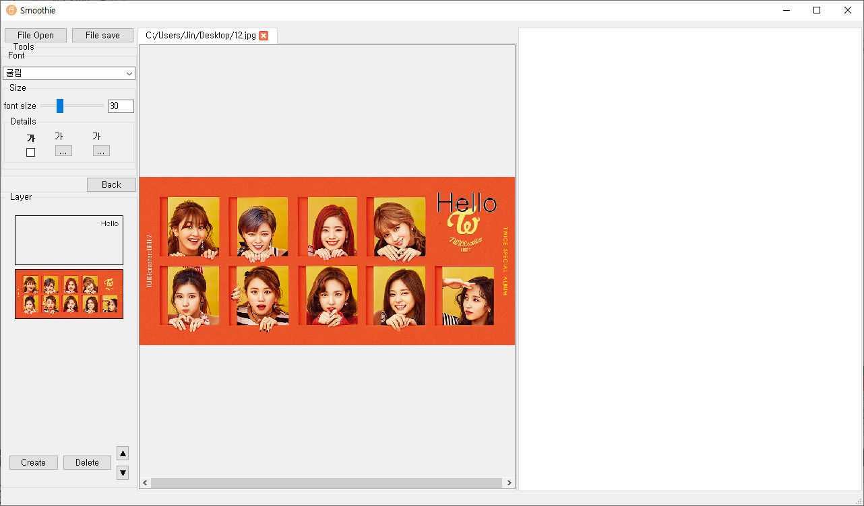
2
Progress
QT
Text

Slide 17
2.2
Lasso Function

Slide 18

2
Progress
Learning Model
Trained Data: MS-COCO 2017

Slide 19
2
Progress
Learning Model
CategoryList
Airplane
Apple
Backpack
Banana
Bear
Bed
Car
Cat
Person
…..
…..
We use Category
80 Category
Notes:
['BG', 'person', 'bicycle', 'car', 'motorcycle', 'airplane', 'bus', 'train', 'truck', 'boat', 'traffic light', 'fire hydrant', 'stop sign', 'parking meter', 'bench', 'bird', 'cat', 'dog', 'horse', 'sheep', 'cow', 'elephant', 'bear', 'zebra', 'giraffe', 'backpack', 'umbrella', 'handbag', 'tie', 'suitcase', 'frisbee', 'skis', 'snowboard', 'sports ball', 'kite', 'baseball bat', 'baseball glove', 'skateboard', 'surfboard', 'tennis racket', 'bottle', 'wine glass', 'cup', 'fork', 'knife', 'spoon', 'bowl', 'banana', 'apple', 'sandwich', 'orange', 'broccoli', 'carrot', 'hot dog', 'pizza', 'donut', 'cake', 'chair', 'couch', 'potted plant', 'bed', 'dining table', 'toilet', 'tv', 'laptop', 'mouse', 'remote', 'keyboard', 'cell phone', 'microwave', 'oven', 'toaster', 'sink', 'refrigerator', 'book', 'clock', 'vase', 'scissors', 'teddy bear', 'hair drier', 'toothbrush']

Slide 20
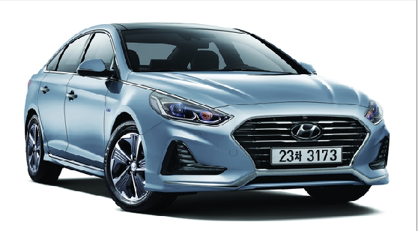
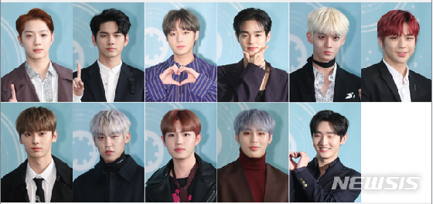

2
Progress
Learning Model

Slide 21
2
Progress
Learning Model

Slide 22
3.
Demo

Slide 23
4.
Further Implementation Plan & Reviews

Slide 24
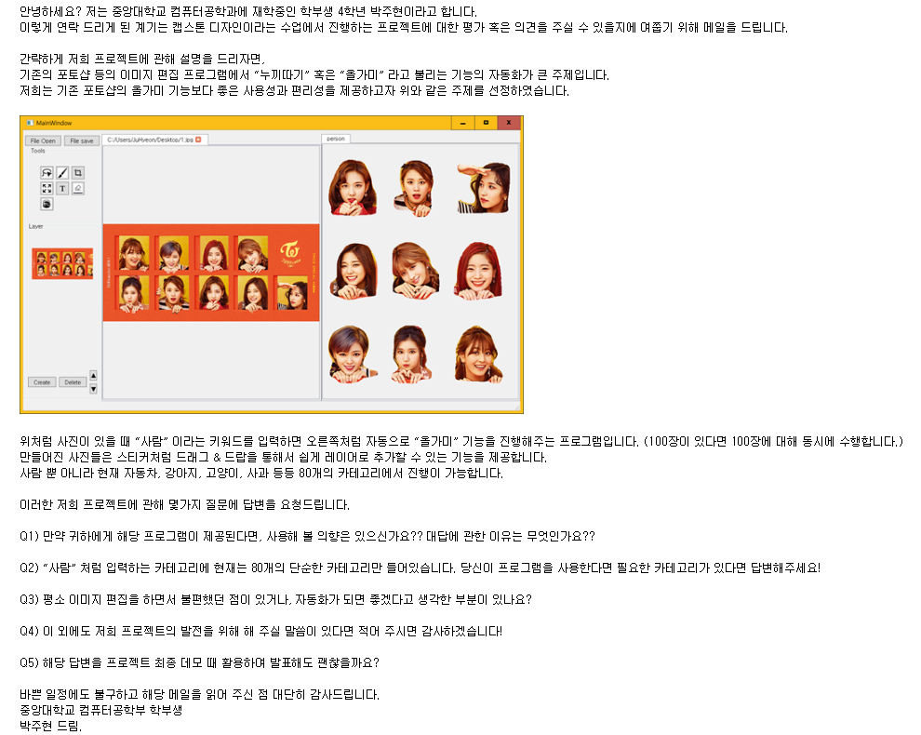
4
Further Implementation Plan & Reviews
Survey
Survey to people who use
Image Edit Program frequently
Snow
Adobe Korea
CAU UBS
CAU News
Computer Vision Start-up company
Game Youtuber
Bora Youtuber
Vlog Youtuber
Baseball Club media team
Riot Games
Freelancer
Power Blogger
….

Slide 25
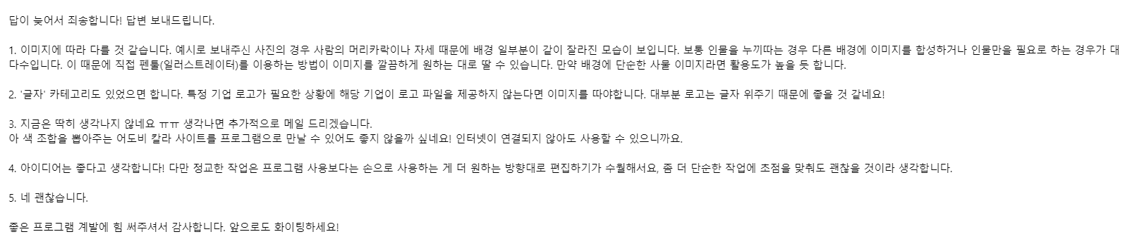
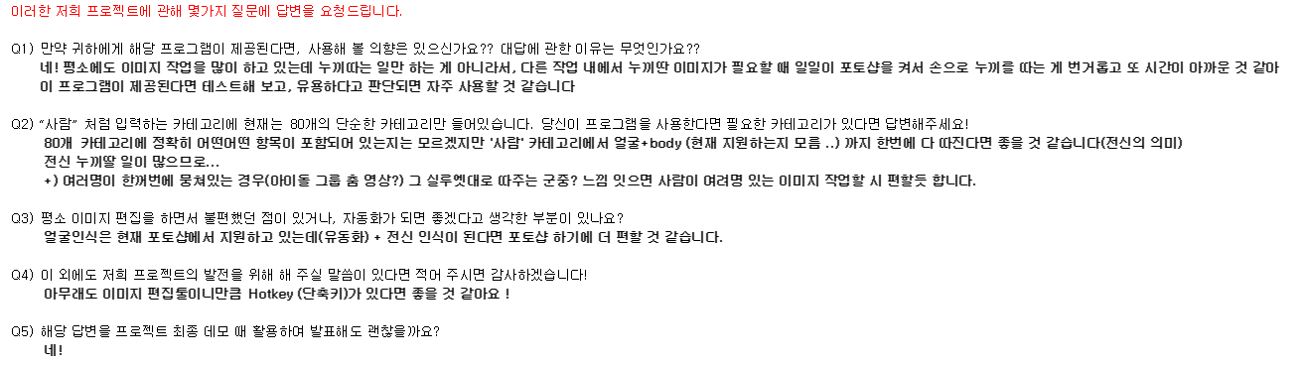
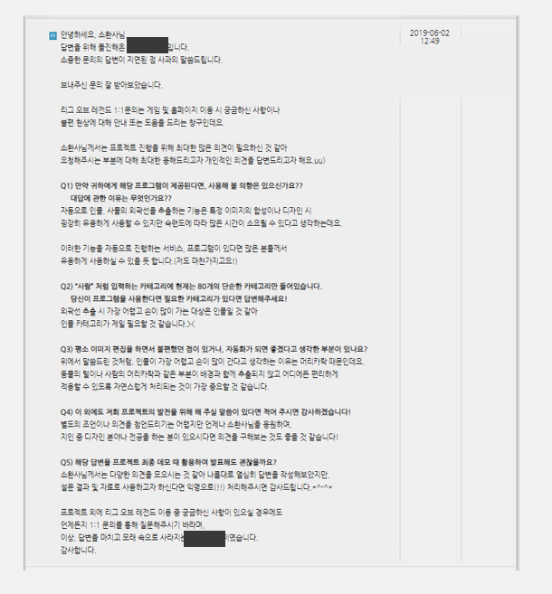
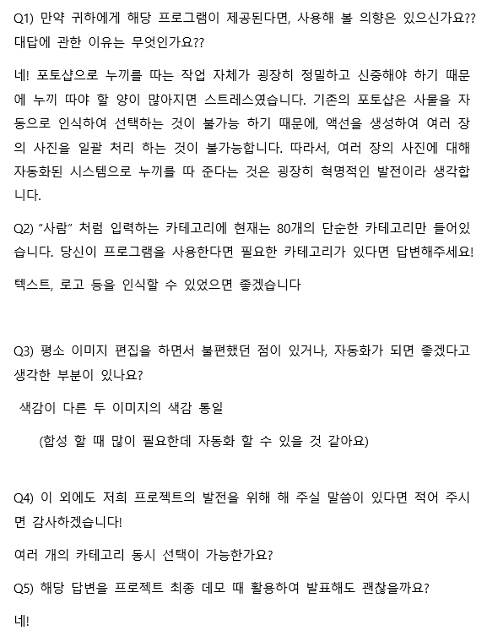
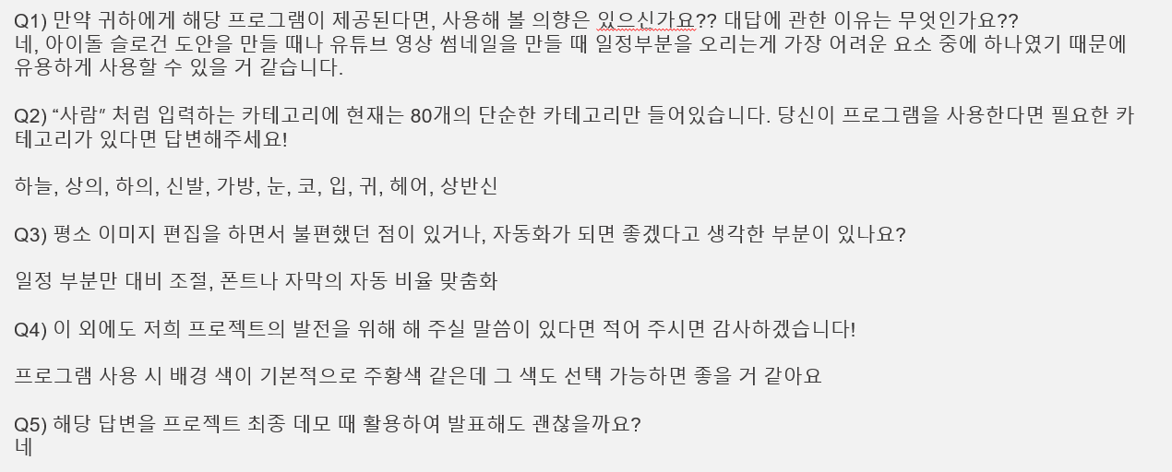
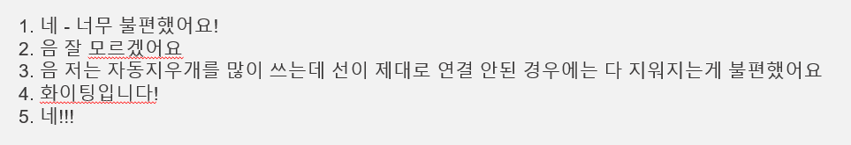
4
Further Implementation Plan & Reviews
Survey

Slide 26
4
Further Implementation Plan & Reviews
Survey Summary
Q1. Will you use this program when it is available? If so, why?
Yes for all response.
For that reason, Easy to Use, Fast to Use, Other tools are too annoying to use.
It seems to be useful because there are a lot of time differences according to proficiency.
Q2.What categories do you need?
Person, Shirts, Pants, Shoes, Face, Bust, Silhouette, Logo, Text

Slide 27
4
Further Implementation Plan & Reviews
Survey Summary
Q3. Do you have any inconveniences while using your usual image editing prorams?
Color matching recommendations or automatic color settings.
Customize auto rate of text or images.
Refining hair part extraction.
Q4.Do you have any additional comments?
Ability to further subdivide extracted photos.
Hot keys.
Focus your sophisticated work on designer work and simple tasks.

Slide 28
4
Further Implementation Plan & Reviews
Plan

Slide 29
4
Further Implementation Plan & Reviews
Review

